Slide 1
ER Diagram Resources

Slide 2
Attributes, Entity Set, Relationship Set
Examples
Attributes (with attribute line)
Entity Sets
Relationship Sets (note, you can edit the name separately from the shape)
Identity Attribute
Entity Set Name
Attribute Name
Identity Attribute
Attribute Name
Weak Entity Set Name
Identity Attribute
Attribute Name
Entity Set Name
Weak Entity Set Name
Relationship
Set Name
ID
Relationship
EX Relationship

Slide 3
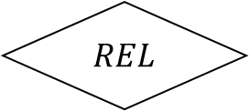
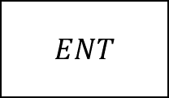
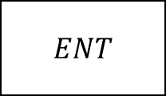




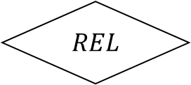


Relationship Constraints
Use only the arrows
Use for roles
$ENT$
$REL$
Role1
$ENT$
$REL$
$ENT$
$REL$
Role2
$ENT$
$REL$
$ENT$
$REL$

Slide 4



IS-A Hierarchy
Our standard usage
PCS Administrator
Generalised
ISA
$\text{Specialise}{\text{d}}_{1}$
$…$
$\text{Specialise}{\text{d}}_{n}$

Slide 5
IS-A Hierarchy
Non-standard usage, can use for project, but we will not ask this
Overlap Constraint | Covering Constraint
 | false | true
false
true
Generalised
Generalised
ISA
ISA
Generalised
Generalised
ISA
ISA

Slide 6





Aggregation
Aggregation is the box surrounding REL_A
$ENT_{1}$
$REL_{A}$
$ENT_{3}$
$REL$
$ENT_{1}$

Slide 7
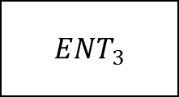
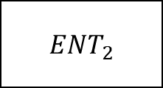
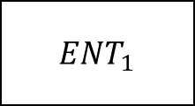
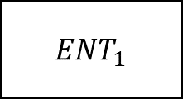

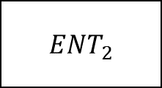

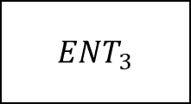








Example of Ternary Relationship
$ENT_{2}$
$ENT_{2}$
$ENT_{1}$
$REL$
$ENT_{3}$
$ENT_{1}$
$REL$
$ENT_{3}$
$ENT_{2}$
$ENT_{2}$
$ENT_{1}$
$REL$
$ENT_{3}$
$ENT_{1}$
$REL$
$ENT_{3}$

Slide 8






Example of Weak Entity Sets
Existential Dependency
Identity Dependency (this is also
$ENT$
$EX$
$ENT_{w}$
$ENT$
$ID$
$ENT_{w}$

Slide 9
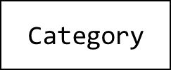

year
month
Date
final_salary
petdays
transport
SalaryEarned
earnings
area
ModeOfTransport
username
PreferredTransport
PreferredModeOfPayment
ModeOfPayment
password
modeOfPayment
gender
User
email
ISA
Full Time Price List
DefaultPriceList
pettype
price
PCS Admin
Pet Owner
$\text{C}$are Taker
Full time
ISA
Rating
Owned
Part Time Price List
Has
Part time
price
Requires
Pet
Availability
pet_count
$\text{C}$ategory
pettype
age
available
Special Care
leave
username
owner
category
date
care
petname
Bids
price_per_day
owner
bid_id
credit_card
start_date
review
pet_name
end_date
completed
CTusername
mode_of_payment
rating
mode_of_transport

